Slide 1

VICKY’S CALCULATOR
Prepared by :
Vikas Malik
Organization :
Nexthikes IT Solutions

Slide 2
Functions available in Calculator
Normal Calculator
Addition
Subtraction
Division
Multiplication
Scientific calculator
Square Root
Radian
Degree
Power
Factorial
Sin Ɵ
Cos Ɵ
Tan Ɵ

Slide 3

Why chose Tkinter Library for making this calculator?
Simplicity and Ease of Use:
Tkinter's syntax is straightforward and easy to learn, making it suitable for beginners and rapid prototyping.
Cross-Platform Compatibility:
Tkinter is available on Windows, macOS, and Linux, allowing applications to run on different operating systems without modification.
Included in Python Standard Library:
Tkinter provides a rangeTkinter comes bundled with Python, eliminating the need for additional installations.
Variety of Widgets:
of widgets, including buttons, labels, text boxes, and menus, for creating interactive user interfaces.
Geometry Management:
Tkinter offers three geometry managers (pack, place, and grid) for arranging widgets within a window.
Event Handling:
Tkinter simplifies event handling, making it easy to respond to user interactions like button clicks and key presses.

Slide 4
Challenges faced while making the Calculator
Python is totally a new domain to work on, as my working was from a non IT background.
Time taking procedure to learn and implement the coding from the libraries .
Implication of additional functions was a time taking task to run through the functions.

Slide 5
References used:
The one and only reference used to perform my task was YOU TUBE Videos . Since I am at a learning stage, I went through number of You Tube videos and spent hours to understand that what exactly is the background function in running of calculator the then came to conclusions and finally completed the project.

Slide 6
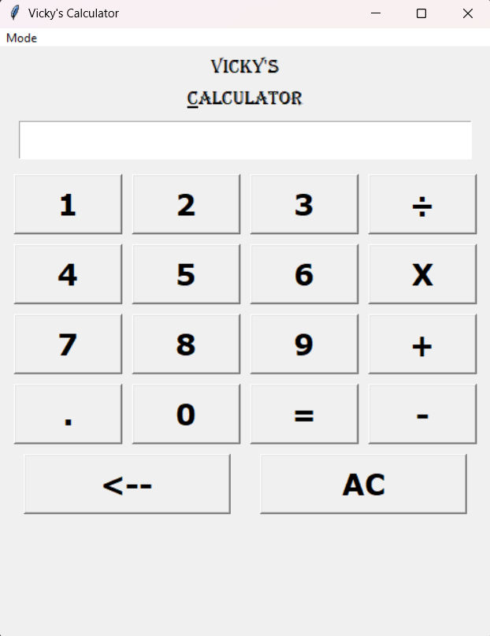
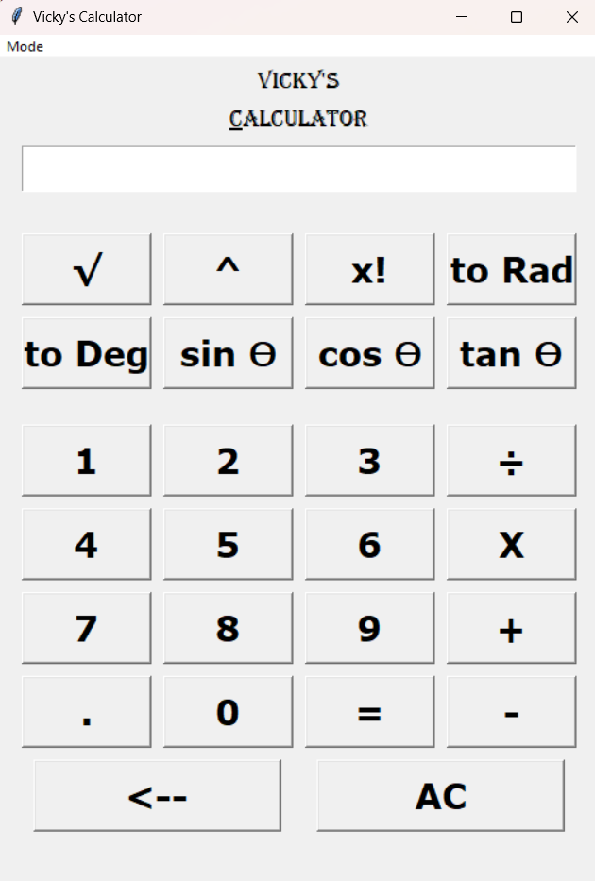
General view of Vicky’s Calculator
NORMAL CALCULATOR MODE
SCIENTIFIC CALCULATOR MODE

Slide 7
THANK YOU🙏

